Slide 1
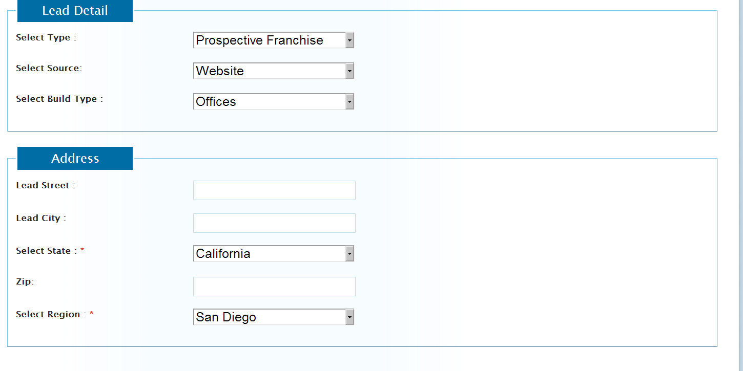
When “prospective Franchise” is selected, we need the following changes BELOW
Fine
Don’t need “build type”
This address section is fine

Slide 2
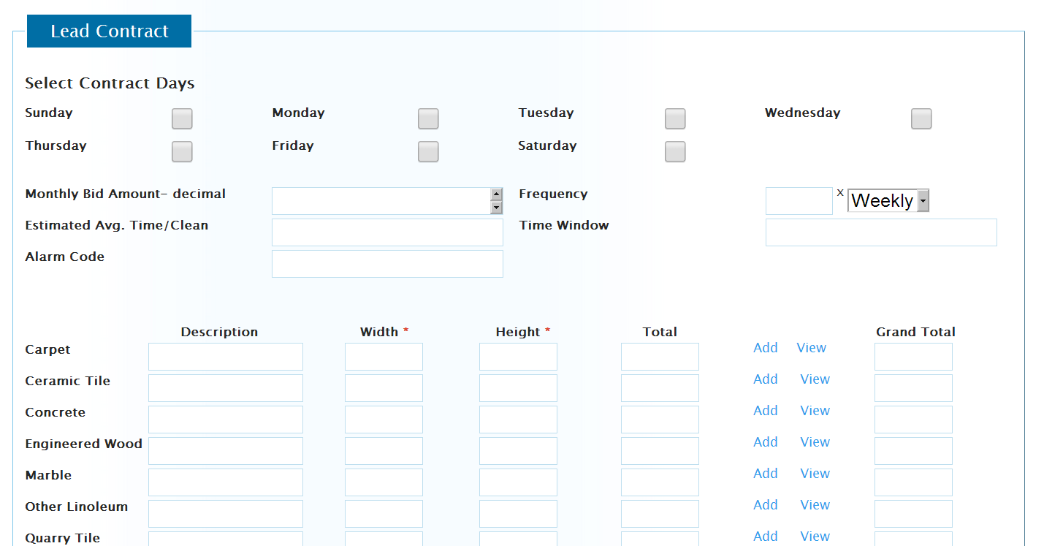
Don’t need this section (Lead Contract) at all!

Slide 3
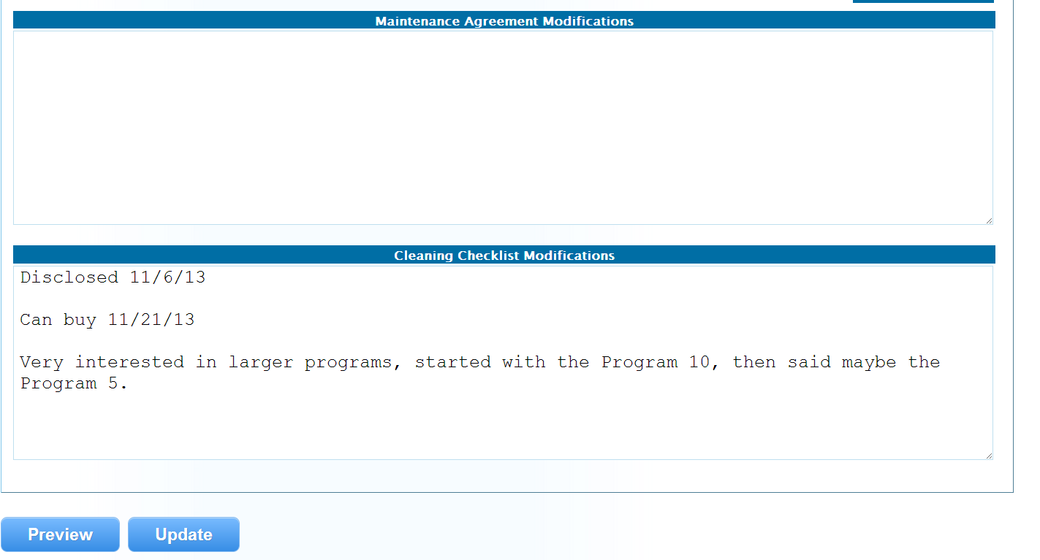
Don’t need “maintenance agreement modifications”
Change this from “Cleaning checklist modifications” to “Notes”

